Slide 1
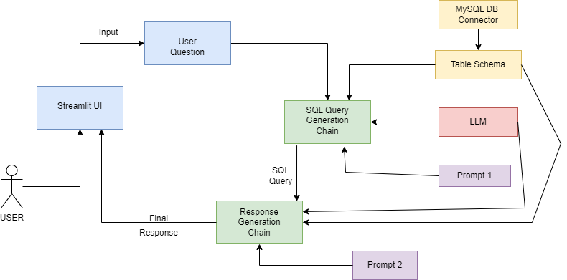
SQL chatbot architecture diagram:
Business value proposition:
Efficient data retrieval
Improved decision making
Reduced manual effort
Quick data analysis
Increased efficiency
Improved accuracy
Features of the application:
Dynamic SQL query generation
Customizable responses
Data visualization charts
Data security
Access control
Interactive User Interface

